Slide 1
Ten Mile Day

Slide 2
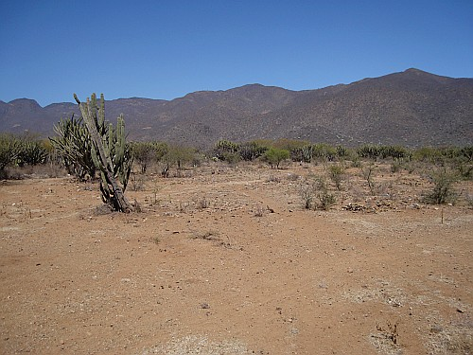
barren: (adj) land that is too poor to produce much or any vegetation, bleak and lifeless

Slide 3
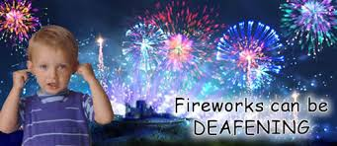
deafening: (adj) so loud as to make it impossible to hear anything else.

Slide 4
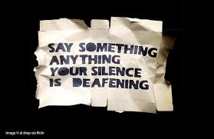

Slide 5
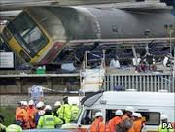
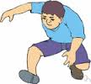
lurched : (v) make an abrupt. unsteady, uncontrolled movement or series of movements

Slide 6
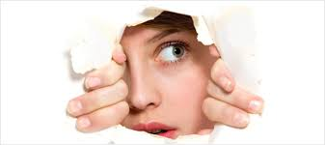
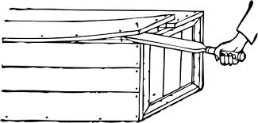
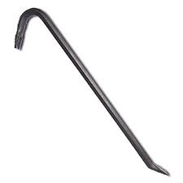
prying: (adj) excessively interested in a person’s private affairs

Slide 7
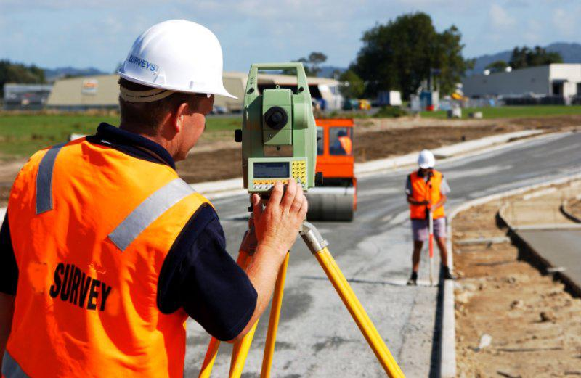
surveying: (v) 1. look carefully and thoroughly at 2. examine and record the area and features of )an area of land) so as to construct a map, plan or description.

Slide 8
allegiance: (n) loyalty or commitment of a subordinate to a superior or of an individual to a group or a cause

Slide 9
emblem: (n) a symbolic object such as a distinctive badge of a nation, organization, or family

Slide 10
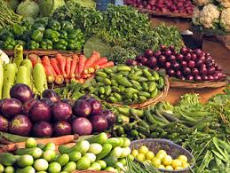
sustenance: (n) food or drink regarded as a source of strength, nourishment

Slide 11
adversity: (n) difficulties, misfortune

