Slide 1
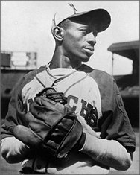
Satchel Paige

Slide 2
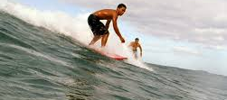
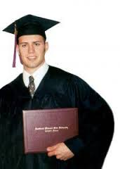
strive: (V) make great efforts to achieve or obtain something

Slide 3
mocking: (adj) making fun of someone or something in a cruel way

Slide 4
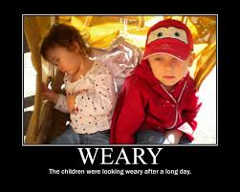
weary : (adj) feeling or showing tiredness, sepecially as a result of excessive exercise

Slide 5
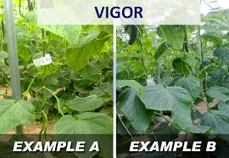
vigor: (n) physical strength and good health

Slide 6
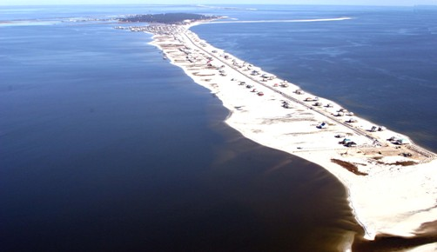
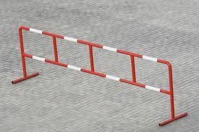
barrier: (N) 1. a fence or other obstacle that prevents movement or access 2. a circumstance or obstacle that keeps people or things apart or prevents communication/progress

Slide 7
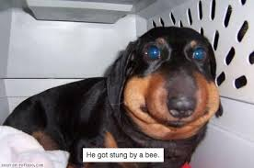
endure: (V) 1. suffer (something painful or difficult) patiently 2. remain in existence

Slide 8
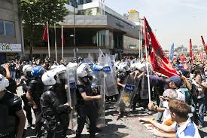
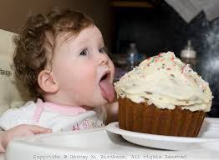
resist: (V) withstand the action or effect of

Slide 9
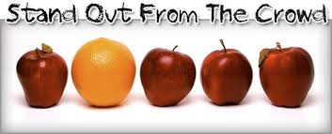
unique being the only one of a kind, unlike anything else

