Slide 1
Minerals
Chapter 9

Slide 2
Mineral
-a naturally occurring solid -inorganic (not made of living things) -has a crystal structure

Slide 3
Color
-A property of minerals -Least reliable property quartz can come in pink, clear, milky white

Slide 4
texture
-a property of minerals -describes how the mineral feels smooth, sticky, grainy, powdery

Slide 5
Luster
-property of a mineral -how light reflects off a mineral -metallic or non-metallic

Slide 6
cleavage
-property of minerals -how many planes a mineral breaks into -mica breaks into sheets- one plane of cleavage

Slide 7
hardness
-a property of minerals -how hard the mineral is -Moh’s hardness scale goes from 1-10 1= soft (can be scratched by fingernail)…..such as talc 3=can be scratched by copper ….calcite 4= can be sctratched by steel –nail…..fluorite 6= can scratch glass…feldspar 10 = hardest….such as diamond

Slide 8
streak
-property of minerals -color of the powder left on an unglazed porcelain tile

Slide 9
Oddball properties
-Magnetic -Density of the mineral -Florescent

Slide 10
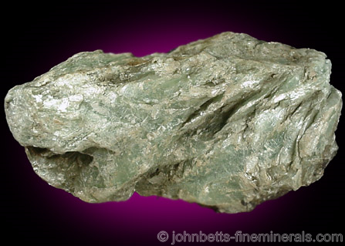
talc
-Softest mineral -1 on Moh’s hardness scale -Used in baby powder, cosmetics

Slide 11
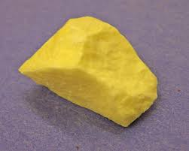
sulfur
-Used in matches -yellow -smells like rotten eggs Trick….sul + fire

Slide 12
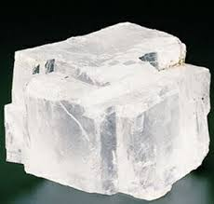
halite
-Rock salt Does not react to acid “Hail” + ite

Slide 13
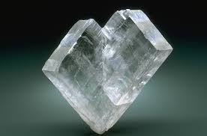
calcite
-Main ingredient used in cement -Does react to acid -One of the most common minerals

Slide 14
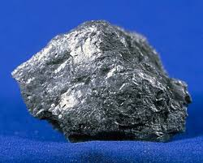
graphite
-Used in pencils -Used in sports equipment because it is strong, light weight **hockey stick, tennis rackets, golf clubs,….

Slide 15
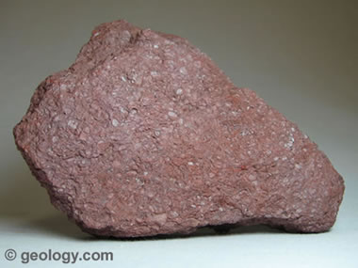
hematite
-Used in iron to make steel -“He” man -Red in color like blood -Hema means blood

Slide 16
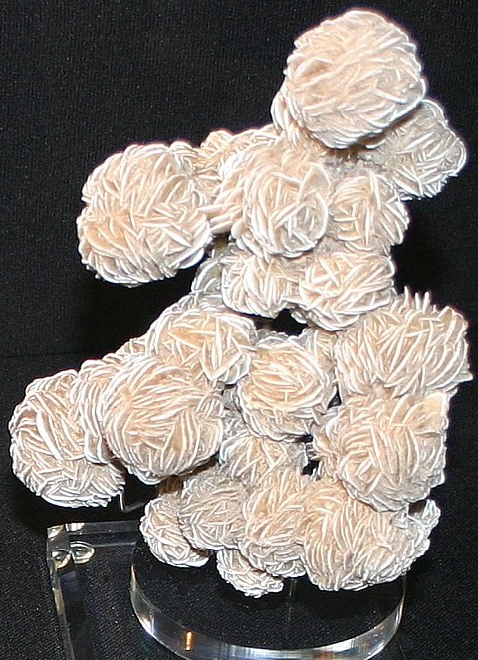
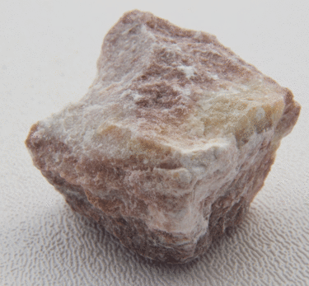
gypsum
-Very soft -Used in plaster of paris, wall boards (dry wall) -Streaks red/black

Slide 17
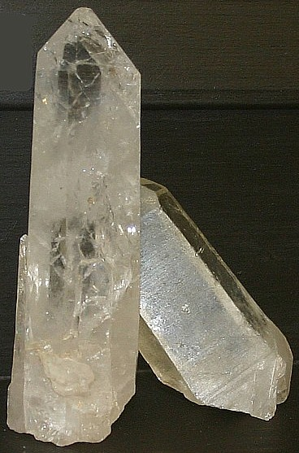
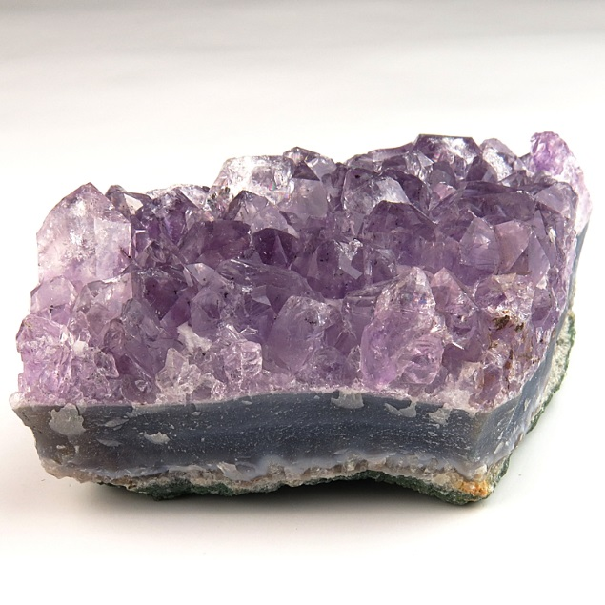
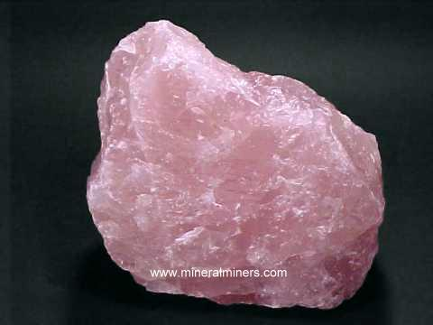
quartz
-Second most abundant mineral -No cleavage -Used in watches, glass -In the sand at beaches - shiny

Slide 18
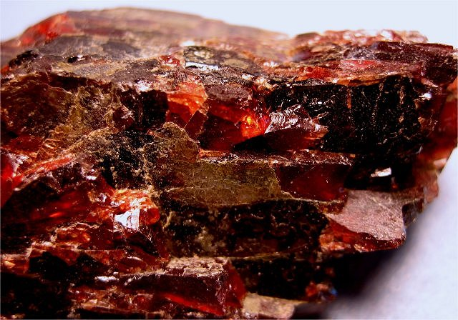
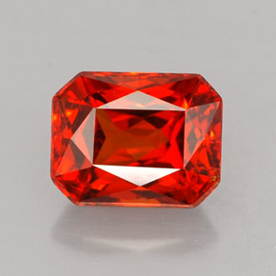
garnet
-Used in sandpaper and jewelry -Red in color

Slide 19
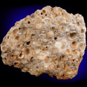
bauxite
-Used in aluminum “box of foil”

Slide 20
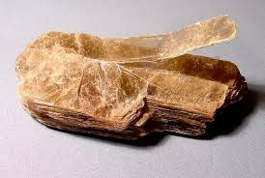
mica
-Cleaves in flat sheets = one plane of cleavage -Used in old fuses, glass

Slide 21
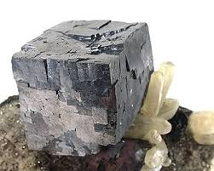
galena
-Source of lead -Usually has a metallic luster

Slide 22
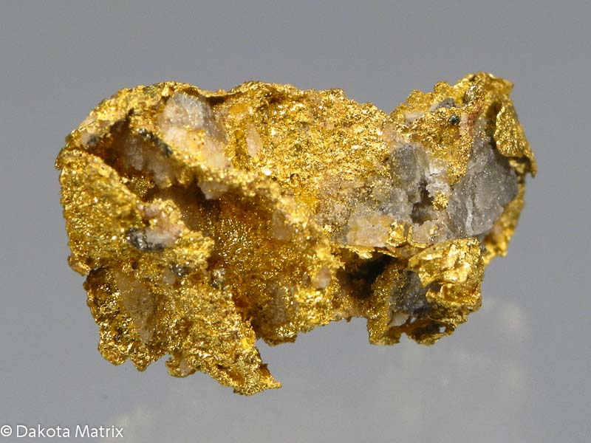
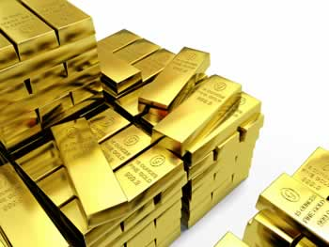
gold
-More rare, which means it is worth more $$ Streaks gold Is the most dense mineral

Slide 23
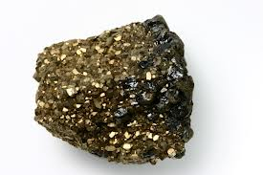
pyrite
-Fool’s gold… “pirates” -Streaks black -Has crystals

Slide 24
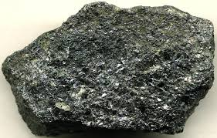
magnetite
-Metallic luster -Is an iron ore -Very heavy **magnetic

Slide 25
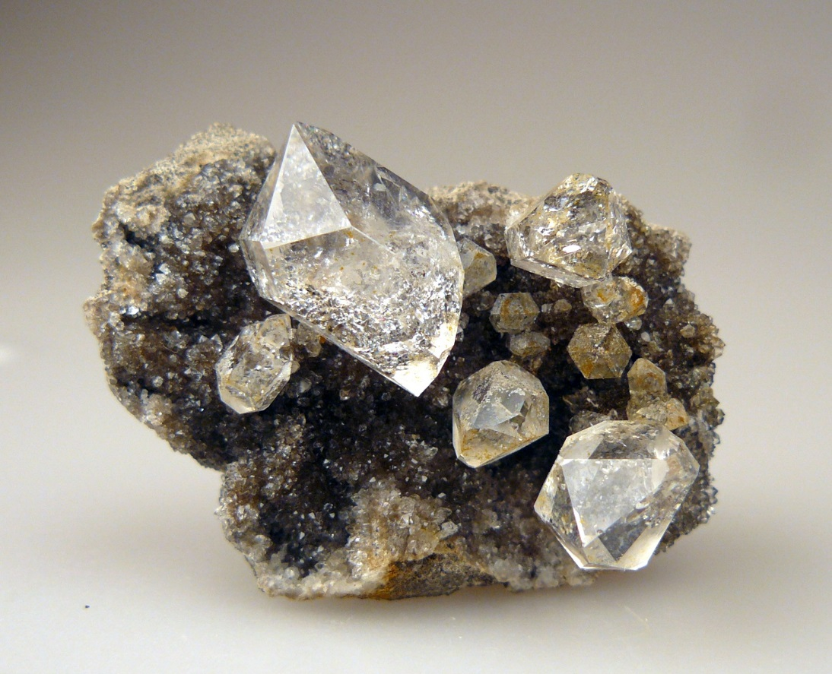
diamond
-Hardest mineral -10 on Moh’s hardness scale -It can scratch glass

Slide 26
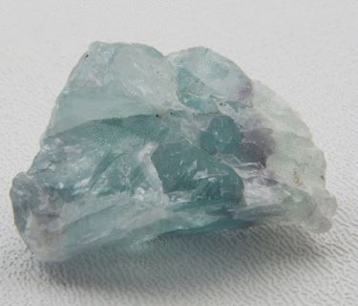
fluorite
-high clarity pieces used to make lenses for microscopes

Slide 27
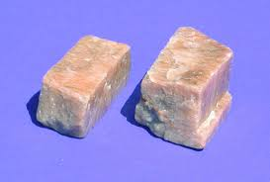
feldspar
-the most abundant mineral -non-metallic -Can scratch glass -weathers into clay -used in china, fertilizer, in chicken feed

Slide 28
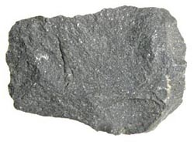
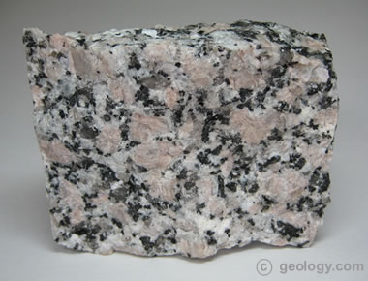
Igneous rocks
-form when melted rock cools and hardens, often have holes -as it cools crystals form -if it cools slowly = large crystals -if it cools quickly = small crystals -granite, basalt, pumice

Slide 29
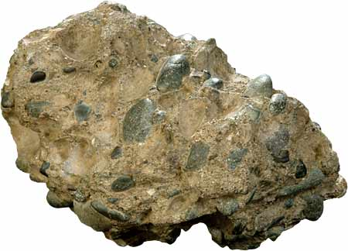
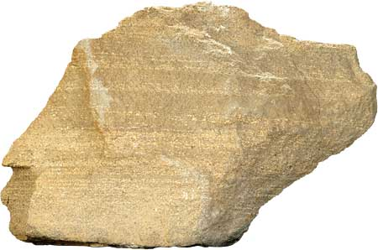
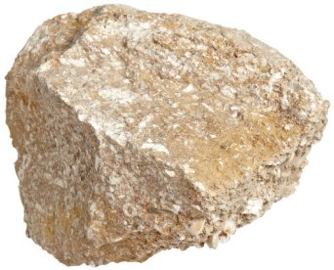
sedimentary rocks
-form when layers of materials and rock particles settle on top of each other and harden. -often found by water sources -some have fossils -examples = sandstone, conglomerate

Slide 30
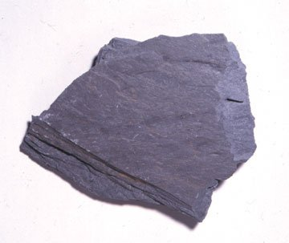
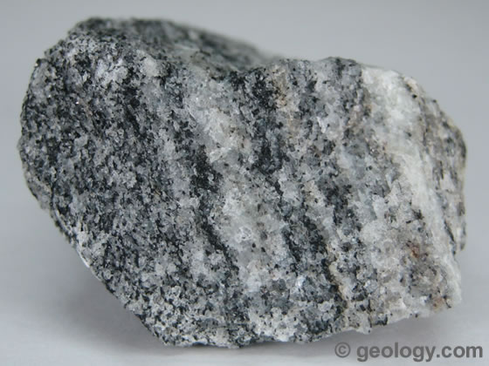
metamorphic rocks
-form when solid rock is squeezed and heated to very high temperatures -examples = gneiss, slate

